Slide 1
iPad Restaurant Application
Hyon Lee, 100488516
Kajan Ravindran, 100608620

Slide 2
Preliminary Analysis
Before any in-depth analysis, pros and cons of the project were discussed.
Pros
Ease of use (customers)
Easy menu updates
Modern appeal
Cons
Investment for hardware
Software implementation
With large investment required compared to traditional ink and paper, our focus will be to increase ease of use, and provide easy updates to the restaurants.
Notes:
Kajan
[before slide contents]
-explain little more about the ipad restaurant application and its current state in restaurant business market
-Purpose of preliminary analysis is to identify project goal and possible risks early on
[proceed to rest of slide content]

Slide 3
Project Objectives
As a software designed for business, objectives of the project is not only just to ensure software runs without fault, but also held at different business standards we’ve established as following:
Appropriate privilege to customers and business respectively
Restaurants should be able to add new menu items/promos
Clients should be able to order with the limited privilege given to them
Synchronized server and client system
Storefront should be notified in almost real-time once the customer makes an order
All prices changes should affect all machines
Notes:
Hyon

Slide 4
Objectives continue
Respective area of operating business should receive customer's order
If restaurant is composed of different parts (e.g. bar or dining)
Speed/quality of software
Ordering through software should be efficient than conventional waitress-notepad methods
Errors made by the software should be lower than expected
Notes:
Kajan

Slide 5
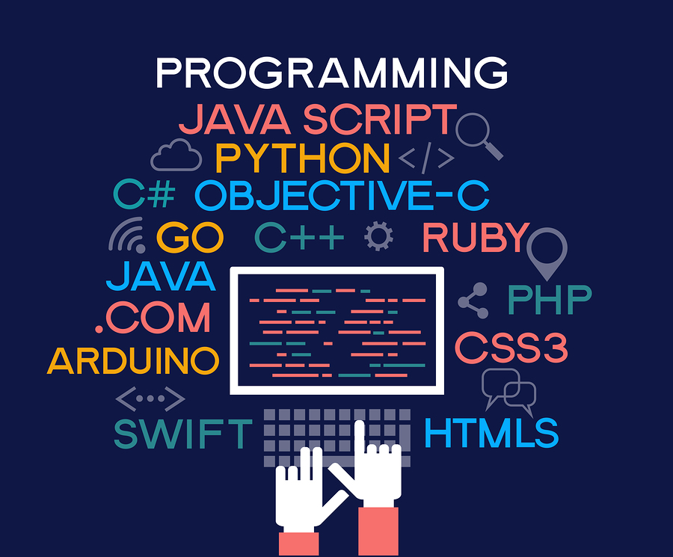

Measurement of success
As discussed in objectives, measurement of success will be based on both software project metrics (i.e. latency, downtime) and as a business product point of view (i.e. customer satisfaction, profit margin)
[img above]https://itchronicles.com/opinion/best-machine-learning-programming-language/
[img below]https://upserve.com/restaurant-insider/what-does-a-restaurant-server-do/
Notes:
Kajan

Slide 6
Measurement of success cont.
Order Failure/ error rate
Likely one of the biggest fear from the clients (software aspect)
Should never exceed threshold provided by the team
Saved cost analysis
Software approach provides cost reduction from various sources (e.g. staffing, prevention of food waste)
Notes:
Kajan
[simplified version of the two points]
Order failure error rate:

Slide 7
Measurement of success cont.
Workplace efficiency
Software implementation reduces human to human interaction, providing shorter order turnaround time
Net profit analysis
Analysis of break-even point, and potential business gains due to software system (i.e. overlooked metrics and relations due to software implementation)
Software life cycle analysis
As a software project intended to be implemented with waterfall development, assess life of the software regarding maintenance, updates
Notes:
Kajan

Slide 8
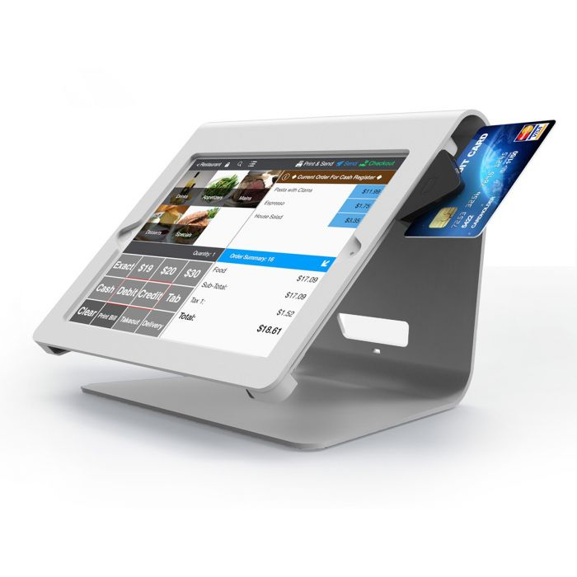
Project Infrastructure: Off-the-shelf
As personalized POS system gets more available, there exists “off-the-shelf” product where our team can fine tune the modularized components to create our own product.
Our first testing for infrastructure will be to perform cost analysis of popular “off-the-shelf” software.
Benefits of off-the-shelf
Cons of off-the-shelf
[img]https://www.maclocks.eu/de/nollie-ipad-kiosk-ipad-pos-kiosk.html
Notes:
Hyon

Slide 9

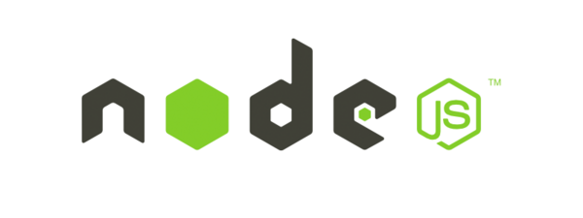

Project Infrastructure: In-house
Based on team discussion, largest part of client based is expected to be small to medium-size business. Considering situation given, we choose waterfall/Iterative-style development**
A three-tier system with data, application and client layer.
Data: local or cloud (based on business size) Application: application hosted on node or locally Client layer: application created using Swift or react native
Notes:
Hyon

Slide 10

Risks and countermeasures:
Development
Unforseen Bugs - addressed during user testing(subtask) - Prototype creation for new features, and frequent testing conducted by both the development team and external testing team
Shareholder modifying requirement during development - Despite waterfall/iterative style. Frequent contact with client during development - Frequent deliverables and prototypes to ensure expectations are translated into product
Unexpected concerns (e.g. emergency outbreak) -Healthy policy to ensure safety of employees (i.e. work from home)
[img]https://medium.com/mutualmobile/ios-bug-fixing-getting-rid-of-programming-pests-3464c52a728b
Notes:
Kajan

Slide 11

Risks and countermeasures:
Deployment
Hardware and software incompatibility - Test deployment on various hardware versions
Shareholder dissatisfaction - addressed in prototype development & concept development (subtask) - Frequent updates for shareholder during development - Consultation to assess what can be done
Outdated hardware or hardware slow down by manufacturer - Test deployment on various version and hardwares to provide alternatives to customers
[img]https://www.realbusinessgroup.com.au/4-root-causes-customer-dissatisfaction/
Notes:
Hyon

Slide 12
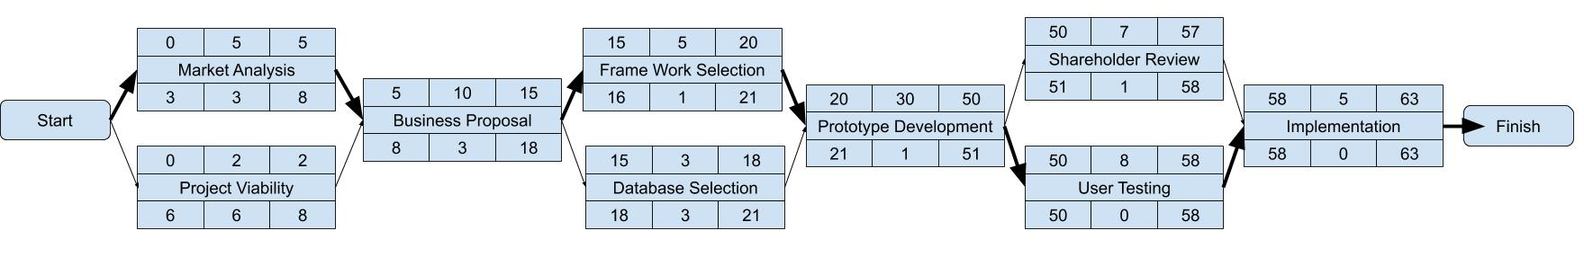
Project Activity: Activity Diagram
Notes:
Kajan

Slide 13
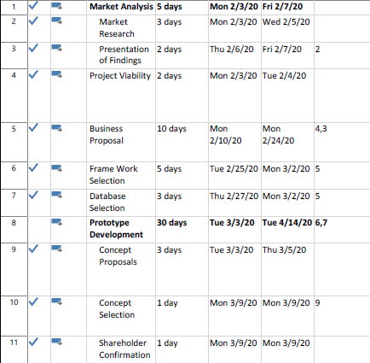
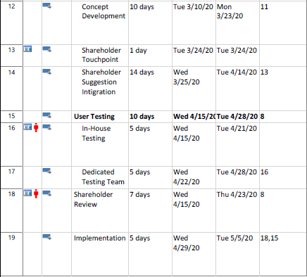
Project Activity: detailed view
Notes:
Kajan

Slide 14
Resources available
There are total 6 roles created for the project
Full stack programmer - Hyon
Tech lead- Kajan
Database administrator
Business Analyst (combined with Sales Lead)
Client Relations
Testing Team
Notes:
Hyon

Slide 15
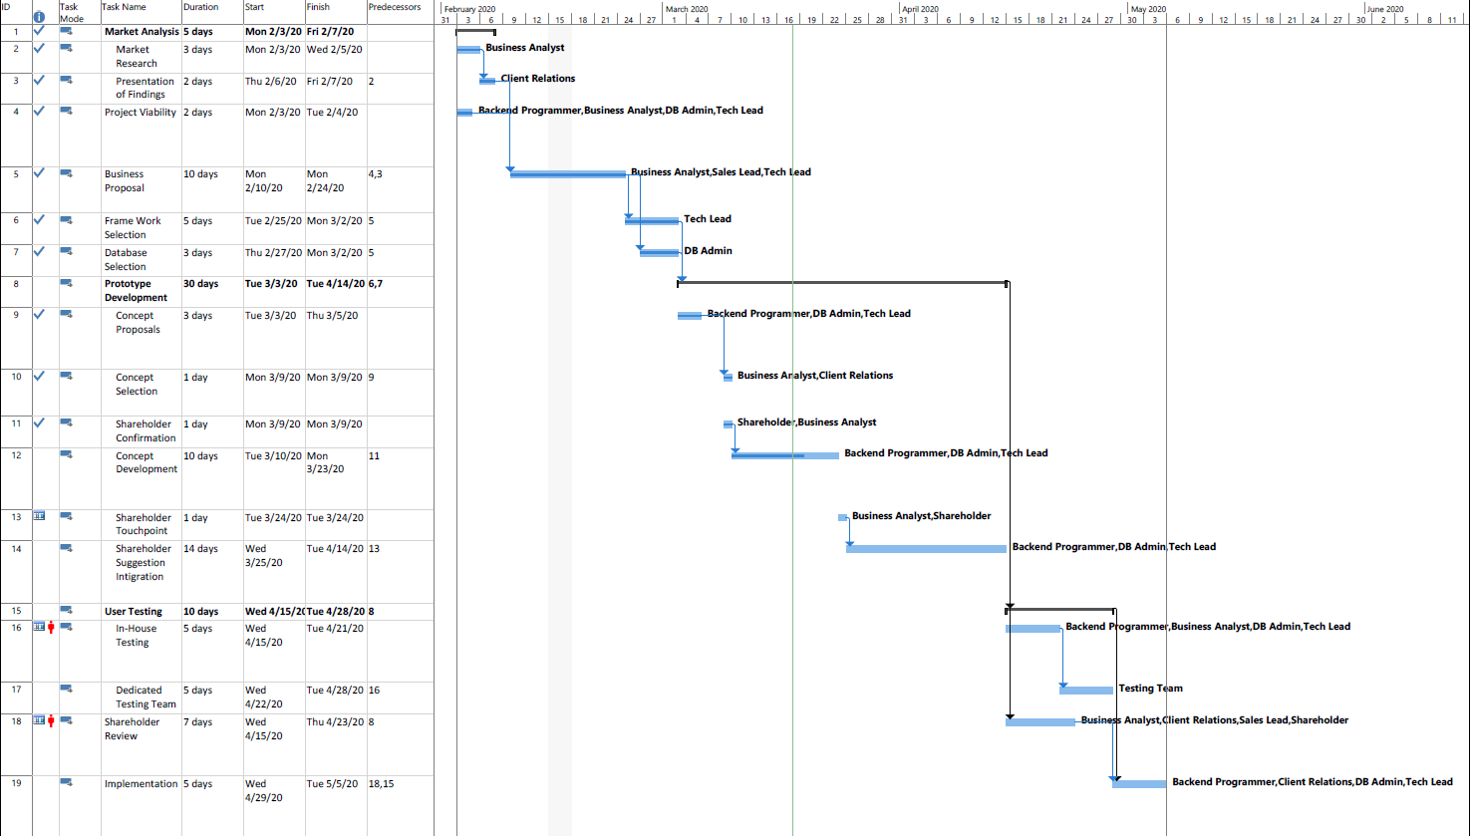
Project Gantt chart

Slide 16
Conclusion
Technology is a growing area in restaurant business market
From analysis, we established clear project objectives to counter the side effects the project.
As a business software, measurement of success needs to be measured both technically and in business perspective
Despite small team and limited resources, work is allocated to maximize efficiency in waterfall/iterative development model
Notes:
Hyon

